Slide 1

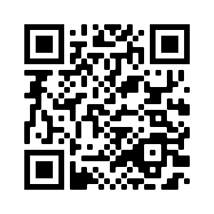
Welcome to…
David E. Bernholdt
RF SciDAC 2020 Workshop
Tutorial slides https://doi.org/10.6084/m9.figshare.11918397
See slide 2 for license details and requested citation

Slide 2
License, Citation and Acknowledgements
License and Citation
This work is licensed under a Creative Commons Attribution 4.0 International License (CC BY 4.0).
The requested citation the overall tutorial is: David E. Bernholdt, Better Scientific Software tutorial, in RF SciDAC 2020 Workshop, Knoxville, Tennessee. DOI: 10.6084/m9.figshare.11918397
Individual modules may be cited as Speaker, Module Title, in Better Scientific Software Tutorial…
Acknowledgements
Additional contributors to this this tutorial include: Anshu Dubey, Mike Heroux, Alicia Klinvex, Jared O’Neal, and Katherine Riley, James M. Willenbring
This work was supported by the U.S. Department of Energy Office of Science, Office of Advanced Scientific Computing Research (ASCR), and by the Exascale Computing Project (17-SC-20-SC), a collaborative effort of the U.S. Department of Energy Office of Science and the National Nuclear Security Administration.
This work was performed in part at the Argonne National Laboratory, which is managed managed by UChicago Argonne, LLC for the U.S. Department of Energy under Contract No. DE-AC02-06CH11357.
This work was performed in part at the Oak Ridge National Laboratory, which is managed by UT-Battelle, LLC for the U.S. Department of Energy under Contract No. DE-AC05-00OR22725.
This work was performed in part at Sandia National Laboratories. Sandia National Laboratories is a multi-mission laboratory managed and operated by National Technology and Engineering Solutions of Sandia, LLC., a wholly owned subsidiary of Honeywell International, Inc., for the U.S. Department of Energy’s National Nuclear Security Administration under contract DE-NA0003525. SAND NO SAND2017-5474 PE

Slide 3
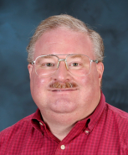

Tutorial Instructors
David Bernholdt, ORNL
Member of the IDEAS Productivity Project: http://ideas-productivity.org
Focus: Increasing CSE software productivity, quality, and sustainability
Member of the RAPIDS SciDAC Institute for Computer Science and Data: https://rapids.lbl.gov/
Focus: assist Office of Science (SC) application teams in overcoming computer science and data challenges in the use of DOE supercomputing resources to achieve science breakthroughs
David

Slide 4
The IDEAS-ECP team works with the ECP community to improve developer productivity and software sustainability as key aspects of increasing overall scientific productivity
Establish software communities
Determine community policies to improve software quality and compatibility
Create Software Development Kits (SDKs) to facilitate the combined use of complementary libraries and tools
1
Customize and curate methodologies
Target scientific software productivity and sustainability
Use workflow for best practices content development
3
Incrementally and iteratively improve software practices
Determine high-priority topics for improvement and track progress
Productivity and Sustainability Improvement Planning (PSIP)
Engage in community outreach
Broad community partnerships
Collaboration with computing facilities
Webinars, tutorials, events
WhatIs and HowTo docs
Better Scientific Software site (https://bssw.io)
2
4

Slide 5

Building an Online Community
https://bssw.io
New community-based resource for scientific software improvement
A central hub for sharing information on practices, techniques, experiences, and tools to improve developer productivity and software sustainability for computational science & engineering (CSE)
Goals
Raise awareness of the importance of good software practices to scientific productivity and to the quality and reliability of computationally-based scientific results
Raise awareness of the increasing challenges facing CSE software developers as high-end computing heads to extreme scales
Help CSE researchers increase effectiveness as well as leverage and impact
Facilitate CSE collaboration via software in order to advance scientific discoveries
Site users can…
Find information on scientific software topics
Contribute new resources based on your experiences
Create content tailored to the unique needs and perspectives of a focused scientific domain

Slide 6
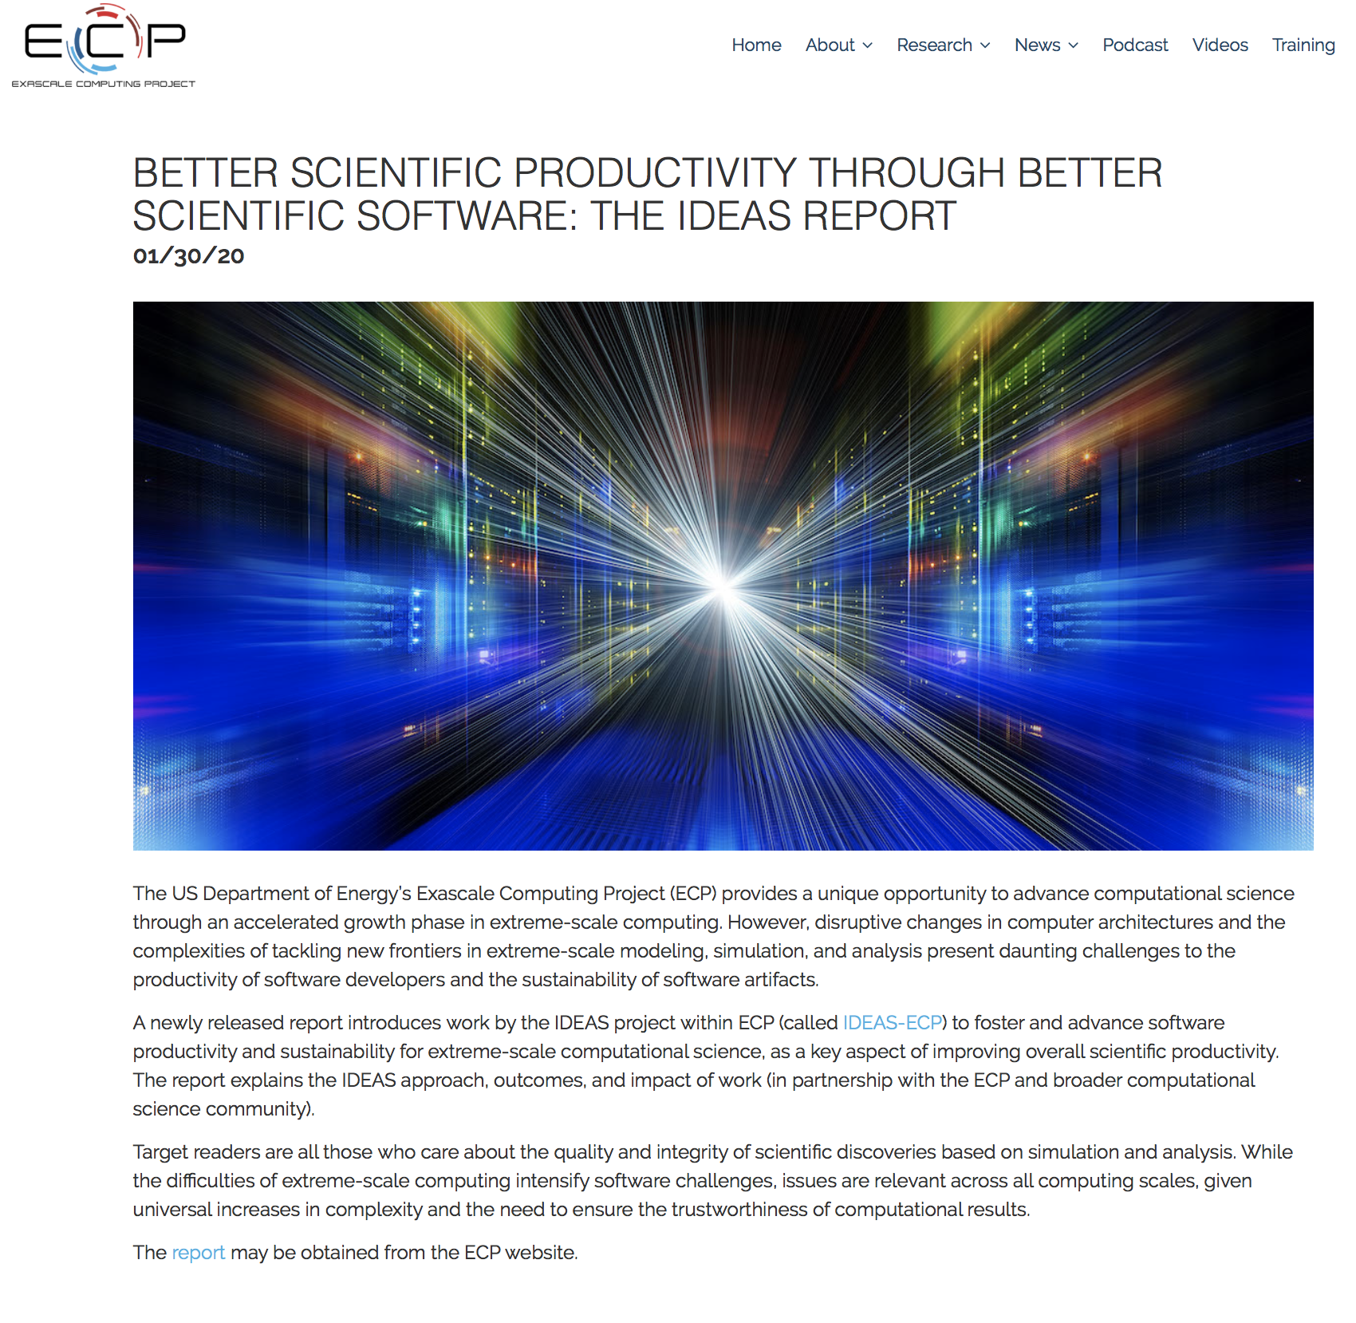
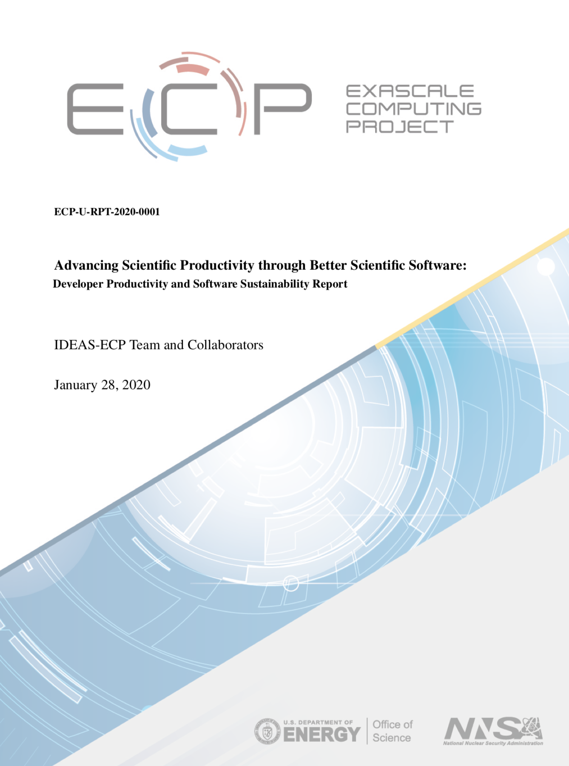
Advancing Scientific Productivity through Better Scientific Software: Developer Productivity and Software Sustainability Report
Disruptive changes in computer architectures and the complexities of tackling new frontiers in extreme-scale modeling, simulation, and analysis present daunting challenges to software productivity and sustainability.
This newly released report explains the IDEAS approach, outcomes, and impact of work (in partnership with the ECP and broader computational science community).
Target readers are all those who care about the quality and integrity of scientific discoveries based on simulation and analysis. While the difficulties of extreme-scale computing intensify software challenges, issues are relevant across all computing scales, given universal increases in complexity and the need to ensure the trustworthiness of computational results.
January 2020
https://exascaleproject.org/better-scientific-productivity-through-better-scientific-software-the-ideas-report

Slide 7


Follow IDEAS and BSSw
IDEAS Productivity mailing list: http://eepurl.com/cQCyJ5
Announcements of IDEAS-organized events
Best Practices for HPC Software Developers webinar series
Major scientific meetings (e.g., SIAM, ISC, SC, etc.)
Typically 1-2 messages per month
BSSw Digest: https://bssw.io/pages/receive-our-email-digest
Updates on BSSw content
New blog posts, events, and resources
BSSw Fellowship
Typically 1-2 messages per month
Also: RSS feed: https://bssw.io/items.rss

Slide 8














The RAPIDS Institute
Solving computer science and data challenges for Office of Science application teams to achieve science breakthroughs on DOE platforms.
Technology Focus Areas
Data Understanding – scalable methods, robust infrastructure, machine learning
Scientific Data Management – I/O libraries, coupling, knowledge management
Platform Readiness – hybrid programming, deep memory hierarchy, autotuning, correctness
Application Engagement
Tiger Teams engage experts in multiple areas
Software productivity: verification and validation, etc.
Outreach activities connect with broader community
Application Engagement & Community Outreach
Tiger Teams
Liaisons |  | Outreach
Data Understanding
Scientific Data Management
Platform Readiness
RAP IDS

Slide 9
Tutorial Objectives
Overview of best practices in software engineering explicitly tailored for CSE
Why: Increase CSE software quality, sustainability, productivity
Better CSE software > better CSE research > broader CSE impact
Who: Practices relevant for projects of all sizes
emphasis on small teams, e.g., a faculty member and collaborating students
Approach:
Useful information, examples, exercises, pointers to other resources
Not to prescribe any particular practices as “must use”
Be informative about practices that have worked for some projects
Emphasis on adoption of practices that help productivity rather than put unsustainable burden
Customize as needed for each project
Remember: your code will live longer than you expect. Prepare for it!
Old Process
New Process
Cost
Start
Progress
Finish

Slide 10
Agenda
Time | Module | Topic | Speaker
1:00pm-1:05pm | 00 | Introduction | David E. Bernholdt, ORNL
1:05pm-1:30pm | 01 | Overview of Best Practices in HPC Software Development | David E. Bernholdt, ORNL
1:30pm-2:00pm | 02 | Agile Methodologies and Useful GitHub Tools | David E. Bernholdt, ORNL
2:00pm-2:30pm | 03 | Improving Reproducibility through Better Software Practices | David E. Bernholdt, ORNL
2:30pm-2:45pm |  | Q&A | All
2:45pm-3:30pm |  | Break
3:30pm-4:15pm | 04 | Software Design and Testing | David E. Bernholdt, ORNL
4:14pm-4:45pm | 05 | Continuous Integration | David E. Bernholdt, ORNL
4:45pm-5:00pm |  | Q&A | All

Slide 11
Agenda
Time | Module | Topic | Speaker
1:00pm-1:05pm | 00 | Introduction | David E. Bernholdt, ORNL
1:05pm-1:30pm | 01 | Overview of Best Practices in HPC Software Development | David E. Bernholdt, ORNL
1:30pm-2:00pm | 02 | Agile Methodologies and Useful GitHub Tools | David E. Bernholdt, ORNL
2:00pm-2:30pm | 03 | Improving Reproducibility through Better Software Practices | David E. Bernholdt, ORNL
2:30pm-2:45pm |  | Q&A | All
2:45pm-3:30pm |  | Break
3:30pm-4:15pm | 04 | Software Design and Testing | David E. Bernholdt, ORNL
4:14pm-4:45pm | 05 | Continuous Integration | David E. Bernholdt, ORNL
4:45pm-5:00pm |  | Q&A | All

